Slide 1
Paramount Tours Review & Payout
File created on: 9/14/2026 6:52:07 PM

Slide 2
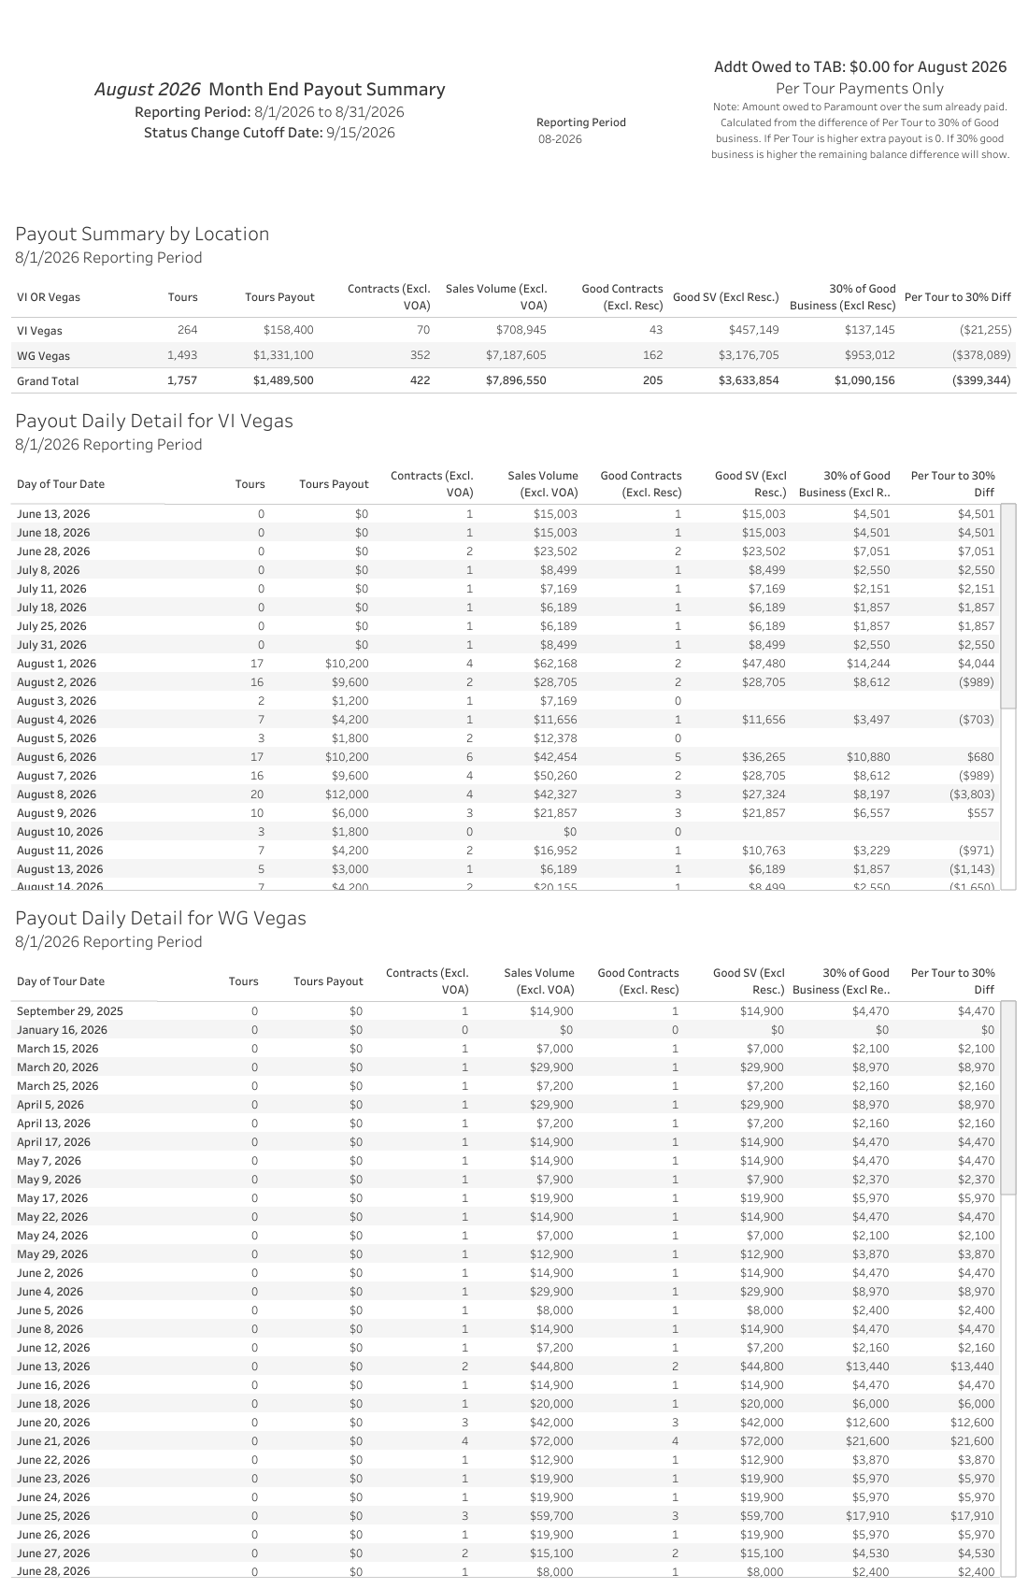

Slide 3
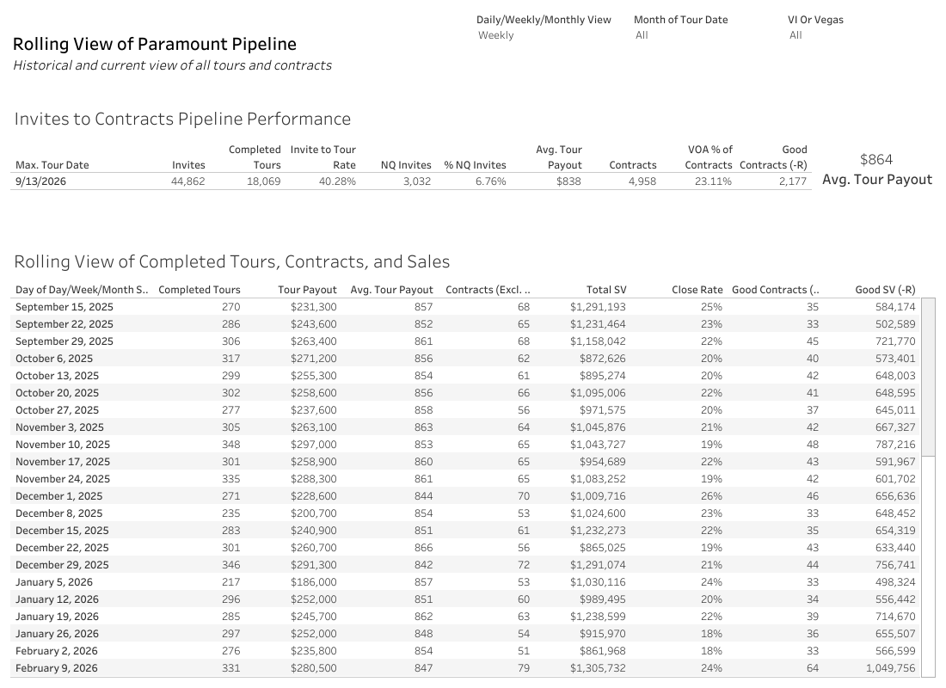

Slide 4
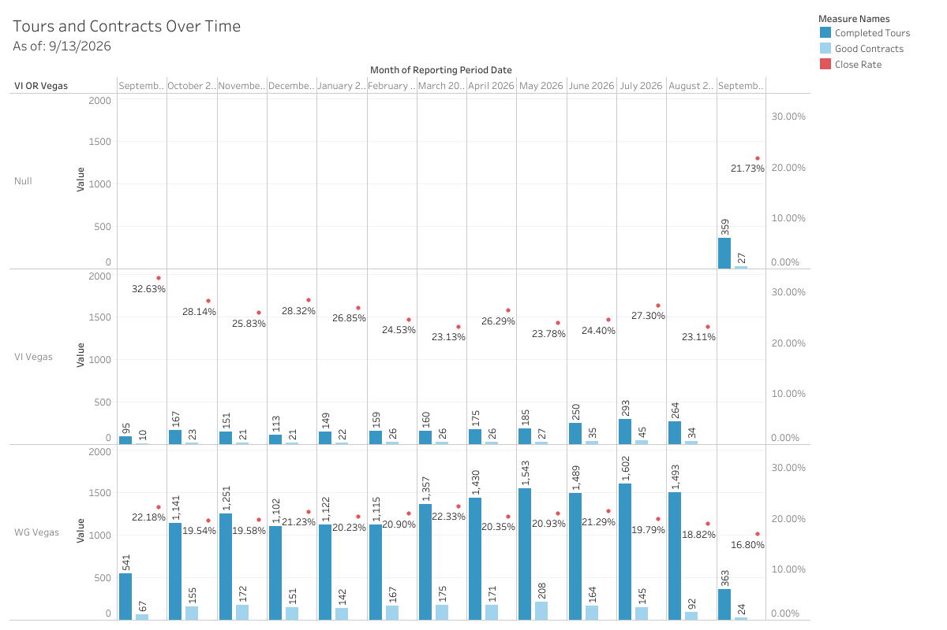

Slide 5
